Slide 1
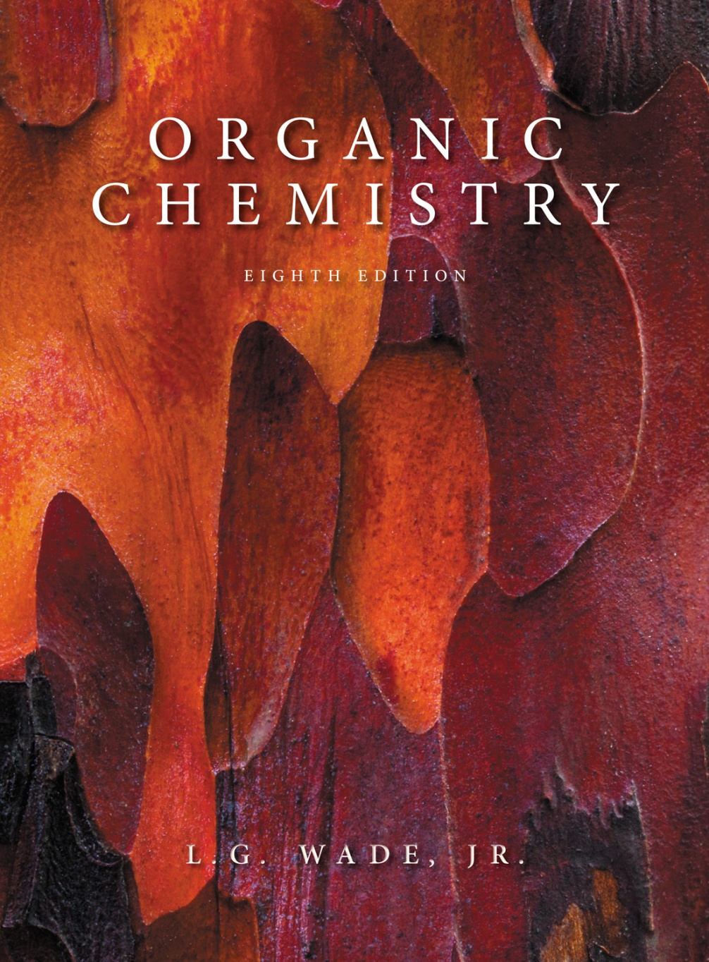
Organic Chemistry, 8e
by L. G. Wade, Jr.
Chapter 6
Clickers
Alkyl Halides: Nucleophilic
Substitution and Elimination
Christine Hermann
Radford University
Radford, VA
Rizalia Klausmeyer
Baylor University
Waco, TX
© 2013 Pearson Education, Inc.

Slide 2
6.1 Give the IUPAC name for (CH₃)₂CBrCH₂CH(CH₃)₂.
a) 2-Bromo-2,4-dimethylpentane
b) 4-Bromo-2,4-dimethylpentane
c) 2-Bromopentane
d) 2-Bromoheptane
e) Isobutyl isopentyl bromide

Slide 3
6.2 Identify the vinyl chloride.
a) ClCH₂CH=CH₂
b) ClCH=CH₂
c) C₆H₅Cl
d) CH₃CH₂Cl
e) CH₃CH(Cl)CH₃

Slide 4
6.3 Identify the secondary alkyl halide.
a) CH₃Br
b) CH₃CH₂Br
c) CH₃CH(Br)CH₃
d) (CH₃)₃CBr

Slide 5
6.4 Identify the type of intermolecular attraction between alkyl halides.
a) Hydrogen bonding
b) London forces
c) Dipole–dipole
d) None

Slide 6
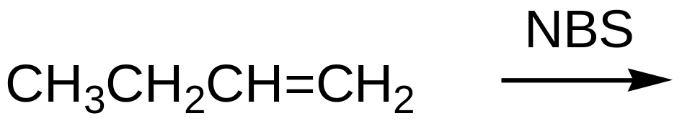
6.5
a) CH₂BrCH₂CH=CH₂
b) CH₃CH(Br)CH=CH₂
c) CH₃CH₂CBr=CH₂
d) CH₃CH₂CH=CHBr

Slide 7
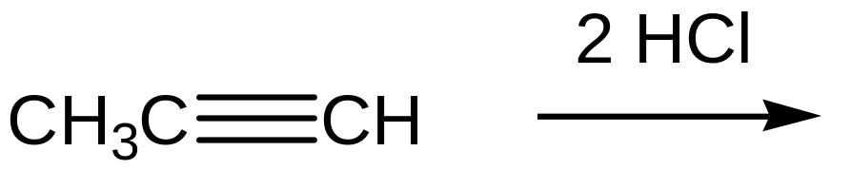
6.6
a) CH₃CH₂CHCl₂
b) CH₃CH(Cl)CHCl
c) CH₃C(Cl)₂CH₃
d) CH₃C(Cl)=CH₂
e) CH₃CH=CHCl

Slide 8
6.7 Identify the strongest nucleophile.
a) CH₃OH
b) (CH₃)₃COH
c) CH₃O⁻
d) (CH₃)₃CO⁻

Slide 9
6.8 Where does the nucleophile attack in an S_{N}2 mechanism?
a) Backside
b) Frontside
c) Both sides
d) Sideways

Slide 10
6.9 Give the rate equation for an S_{N}2 mechanism.
a) k[RX][RX]
b) k[RX][Nu]
c) k[Nu][Nu]
d) k[RX][B]

Slide 11
6.10 Identify the alkyl halide that reacts the fastest in an S_{N}1 mechanism.
a) CH₃Cl
b) CH₃CH₂Cl
c) (CH₃)₂CHCl
d) (CH₃)₃CCl

Slide 12
6.11 Identify the best solvent for an S_{N}1 reaction.
a) CH₃OCH₃
b) (CH₃)₃N
c) CH₃CH₂OH
d) CCl₄

Slide 13
6.12 In an S_{N}1 reaction, a 2º carbocation is formed. What happens next?
a) Rearrangement may occur to form a 1º carbocation.
b) Rearrangement may occur to form a 3º carbocation.
c) The nucleophile attacks.
d) The leaving group departs.

Slide 14
6.13 What is the order for an E1 reaction?
a) Zero order
b) First order
c) Second order
d) Third order

Slide 15
6.14 Identify the alkyl halide that reacts the fastest in an E1 mechanism.
a) CH₃Cl
b) CH₃CH₂Cl
c) (CH₃)₂CHCl
d) (CH₃)₃CCl

Slide 16
6.15 According to Zaitsev’s rule, what alkene is formed in the highest yield?
a) Least substituted alkene
b) Most substituted alkene
c) Does not matter
d) A diene

Slide 17
6.16 What stereochemistry is needed for an E2 reaction?
a) Anti-coplanar arrangement with H and X on adjacent carbons
b) Syn-coplanar arrangement with H and X on adjacent carbons
c) H and X on the same carbon
d) H and X two carbons apart

Slide 18
6.17 Describe an E2 mechanism.
a) Not stereospecific and not concerted
b) Stereospecific and not concerted
c) Stereospecific and concerted
d) Not stereospecific and concerted

Slide 19
6.18 What conditions are best for the E2 mechanism?
a) Weak acid
b) Strong acid
c) Weak base
d) Strong base

Slide 20
6.19 Why can’t CH₃Br undergo the E2 reaction?
a) Bromide is a poor leaving group.
b) The base cannot attack.
c) CH₃Br is solvated in the solvent.
d) Two carbons are needed to make a double bond

Slide 21
6.20 Give the major mode of reaction for primary alkyl halides.
a) S_{N}1
b) S_{N}2
c) E1
d) E2

